Slide 1
FHA Loan Programs for Financing
Energy-Related Features/Improvements
Presented by:
Kevin Stevens—Director, Office of Single Family Program Development, Federal Housing Administration (FHA)
Patricia McBarron—Credit Policy Specialist, Office of Single Family Program Development, HMID

Slide 2

Agenda
Title I
Property Improvement Loans
Title II
Solar and Wind Technologies
203(k) Rehabilitation Mortgages
Energy Efficient Mortgages
Weatherization
Energy Efficient Homes
Notes:
All FHA Forward Mortgages—FHA Portfolio by Fiscal Year
2012 — 1,239,417
2013 — 1,404,764
2014 — 837,969
2015 — 1,174,220
2016 — 1,306,924

Slide 3
Title I Property Improvement Loans
Key Features
Improvements must improve livability or utility of the property
Permanently attached and part of the realty
Loan limit $25,000 for 1-unit (higher for multi)
Lien:
  1st, or 2nd position
  3rd position when 2nd lien connected to down payment assistance
  Unsecured if ≤ $7,500
Notes:
All FHA HECM Loans—FHA Portfolio by Fiscal Year
2012 — 54,187
2013 — 59,923
2014 — 51,616
2015 — 57,990
2016 — 48,863

Slide 4
Title I Property Improvement Loans
Not Required
  Credit score
  Property Appraisal
  Equity
  Energy assessment
  Cost-effective test
  Partial qualification
Information online:
http://portal.hud.gov/hudportal/documents/huddoc?id=TI_PI_AllowLoanPar.doc
http://portal.hud.gov/hudportal/HUD?src=/program_offices/housing/sfh/title
Notes:
FHA Single Family Forward Purchase Mortgages—Percentage of First-Time Home Buyers
2012 — 77.6 percent
2013 — 78.7 percent
2014 — 81.2 percent
2015 — 81.5 percent
2016 — 82.5 percent

Slide 5
Title I Property Improvement Loan Volume
Ending Quarter 2, FY 2017
Notes:
FHA Single Family Forward Mortgages—Percentage of Minority Borrowers
2012 — 27.3 percent
2013 — 28.3 percent
2014 — 32.3 percent
2015 — 32.5 percent
2016 — 32.6 percent

Slide 6
Solar and Wind Technologies
Features:
Add to base loan amount the lesser of:
  New solar or wind energy system cost, or
  20 percent of property value
Appraised value must not include system value
Borrower must own system (not lease)
Borrower must qualify on total loan (w/system cost)
Not Required:
Energy Assessment, Cost-effective test, Partial qualification

Slide 7
Solar and Wind Technologies
Loan Amount Example for Home Purchase
$400,000 Sales Price | $415,000 Appraised Value
$386,000 | 96.5% maximum base loan amount on lesser of sales price or appraised value
+ $20,000 | full cost of new solar system
$406,000 | base FHA loan amount
+ $ 7,105 | Upfront Insurance Premium 1.75%
$413,105 | Total loan amount for which borrower must qualify
Notes:
FHA Single Family Forward Mortgages—Percentage of Minority Borrowers
2012 — 27.3 percent
2013 — 28.3 percent
2014 — 32.3 percent
2015 — 32.5 percent
2016 — 32.6 percent

Slide 8
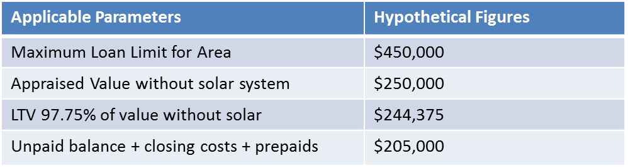
Solar and Wind Technologies
Loan Amount Example for Rate/Term Refinance
$205,000 — the lesser of hypothetical figures
+$ 20,000 — plus full cost of new solar system
$225,000 — equals total base loan amount
+$ 3,937 — plus 1.75% of total base for Upfront MIP
$228.937 — total loan amount borrower must qualify for
Footnote: This maximum loan formula applies to borrowers who have lived in the home for at least 12 months. Other loan amount formulas apply for borrowers who have lived in the property less than 12 months.
Notes:
FHA Single Family Forward Mortgages—Percentage of Minority Borrowers
2012 — 27.3 percent
2013 — 28.3 percent
2014 — 32.3 percent
2015 — 32.5 percent
2016 — 32.6 percent

Slide 9
203(k) Rehabilitation Mortgage
Key Features:
Improve and repair homes — not limited to energy-type
Finance the lesser of the
  Purchase price (or appraised value if refinance) + improvement cost, or
  110 percent of after-improved appraised value
Borrower must qualify on total loan amount w/ improvements.
Volume 203(k) with EE improvements: 5,000 – 6,000/yr.
Not Required:
Energy assessment, cost-effective test, partial qualification
Notes:
FHA Single Family Forward Mortgages—Percentage of Minority Borrowers
2012 — 27.3 percent
2013 — 28.3 percent
2014 — 32.3 percent
2015 — 32.5 percent
2016 — 32.6 percent

Slide 10
203(k): Volume
Ending Quarter 2, FY 2017 (3/20/2017)
Notes:
FHA Single Family Forward Mortgages—Percentage of Minority Borrowers
2012 — 27.3 percent
2013 — 28.3 percent
2014 — 32.3 percent
2015 — 32.5 percent
2016 — 32.6 percent

Slide 11
Energy Efficient Mortgages
Requirements:
Home Energy Assessment
Improvements must be recommended on the Assessment Report
Financed improvements must be cost-effective Test – means they must pay for themselves with energy projected to be saved
Maximum financeable energy package that can be added to the Base Loan Amount is the lesser of:
  the cost of the cost-effective energy package as determined by the home energy audit; or
b) the lesser of 5 percent of:
    the Adjusted Value;
    115 percent of the median area price of a Single Family dwelling; or
    150 percent of the national conforming mortgage limit.
Notes:
FHA Single Family Forward Mortgages—Percentage of Minority Borrowers
2012 — 27.3 percent
2013 — 28.3 percent
2014 — 32.3 percent
2015 — 32.5 percent
2016 — 32.6 percent

Slide 12
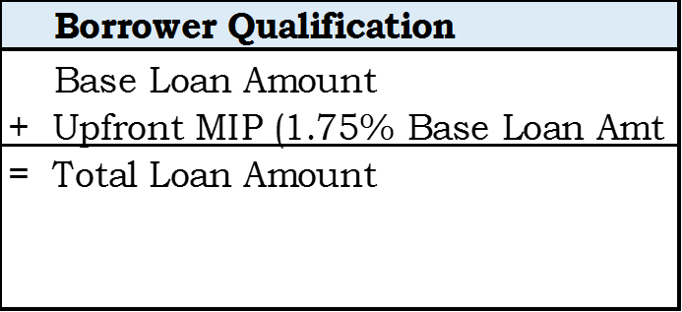
EEM: Borrower Qualifies without Energy Package
Notes:
FHA Single Family Forward Mortgages—Percentage of Minority Borrowers
2012 — 27.3 percent
2013 — 28.3 percent
2014 — 32.3 percent
2015 — 32.5 percent
2016 — 32.6 percent

Slide 13
EEM: Volume
Ending Quarter 2, FY 2017 (3/20/2017)
Notes:
FHA Single Family Forward Mortgages—Percentage of Minority Borrowers
2012 — 27.3 percent
2013 — 28.3 percent
2014 — 32.3 percent
2015 — 32.5 percent
2016 — 32.6 percent

Slide 14
Weatherization
Finance on top of base loan amount, up to:
$2,000 (not to exceed actual cost) without a separate value determination, or
$3,500 (not to exceed actual cost) if supported by a value determination made by an approved FHA Roster Appraiser, or
Borrowers qualify normally - on total loan (with improvements)
Not Required:
Energy Assessment, Cost-effective test, Partial qualification
Notes:
FHA Single Family Forward Mortgages—Percentage of Minority Borrowers
2012 — 27.3 percent
2013 — 28.3 percent
2014 — 32.3 percent
2015 — 32.5 percent
2016 — 32.6 percent

Slide 15
Energy Efficient Homes
Permits 2 percent “stretch” on qualifying ratios for mortgages secured by an Energy Efficient Home (EEH)
EEH = Homes that score 6 or higher using DOE’s Home Energy Score assessment model
Borrower can make improvements to reach the “6” score – via 203(k)
EEH is a compensating factor that allows higher ratios on a manual underwriting process.
Notes:
FHA Single Family Forward Mortgages—Percentage of Minority Borrowers
2012 — 27.3 percent
2013 — 28.3 percent
2014 — 32.3 percent
2015 — 32.5 percent
2016 — 32.6 percent

